Slide 1
Project 1
Module 07

Slide 2
What is a project?

Slide 3
Project: Any undertaking, carried out individually or collaboratively and possibly involving research or design, that is carefully planned (usually by a project team) to achieve a particular aim.

Slide 4
How do we carefully plan a project?

Slide 5

Project Management
The practice of initiating, planning, executing, controlling, and closing the work of a team to achieve specific goals and meet specific success criteria at the specified time.
The primary challenge of project management is to achieve all of the project goals within the given constraints.
wikipedia.org
Notes:
shutterstock_94248952

Slide 6
What is the definition of agile?

Slide 7
agile [ aj-uhl, -ahyl ]
01
Quick and well-coordinated in movement; lithe: an agile leap.
02
Active; lively: an agile person.
03
Marked by an ability to think quickly; mentally acute or aware: She's 95 and still very agile.
dictionary.com

Slide 8
What is agile software development?

Slide 9
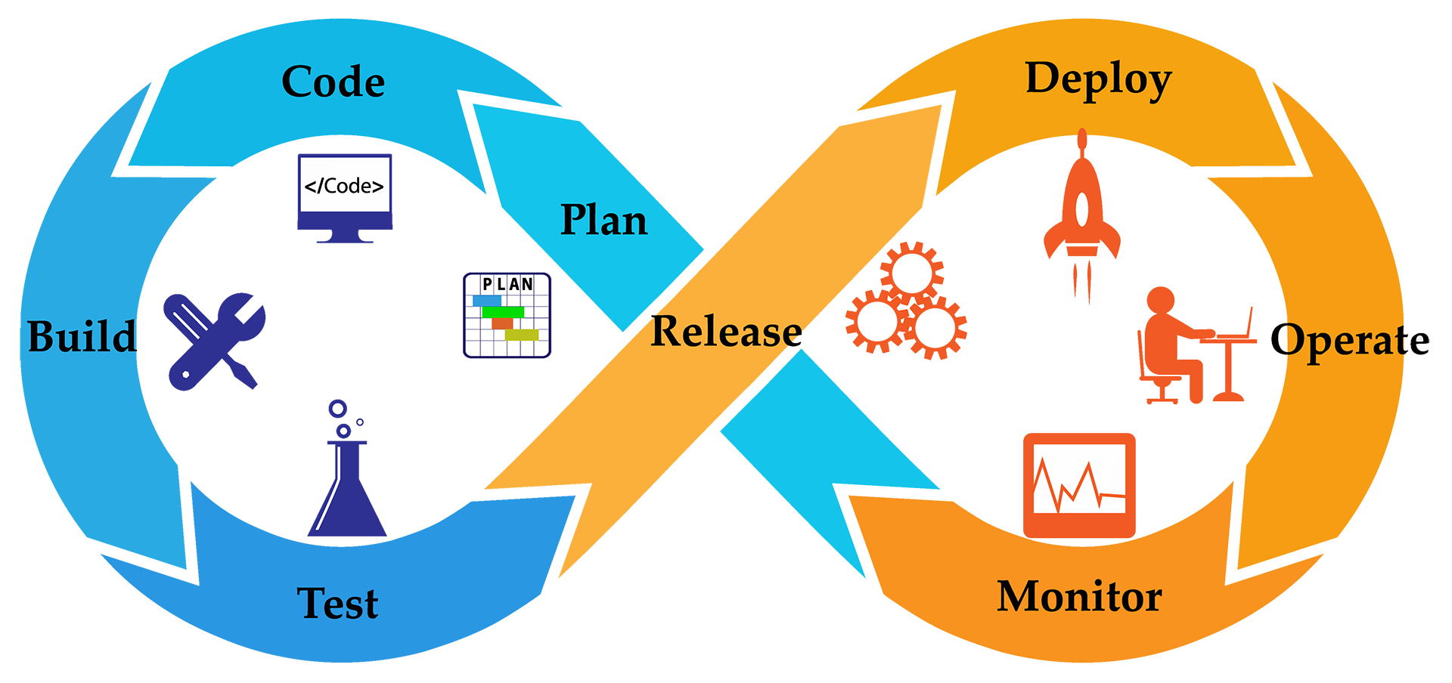
Agile Software Development
Agile software development is an iterative approach to software development.
wikipedia.org
Notes:
shutterstock_538046059

Slide 10

Agile Software Development
Deliver Value
Respond to Change
Teams deliver value to their customers faster by working incrementally rather than working towards a big launch.
Teams improve and respond to change by continuously evaluating project plans, requirements and user needs.

Slide 11
What is iterative development?

Slide 12
Iterative and Incremental Development
Working software is the primary measure of progress
The Agile Manifesto: The Four Foundational Values
Individuals and interactions | over | Processes and tools
Working product | over | Comprehensive documentation
Customer collaboration | over | Contract negotiation
Responding to change | over | Following a plan

Slide 13
What is an MVP?

Slide 14
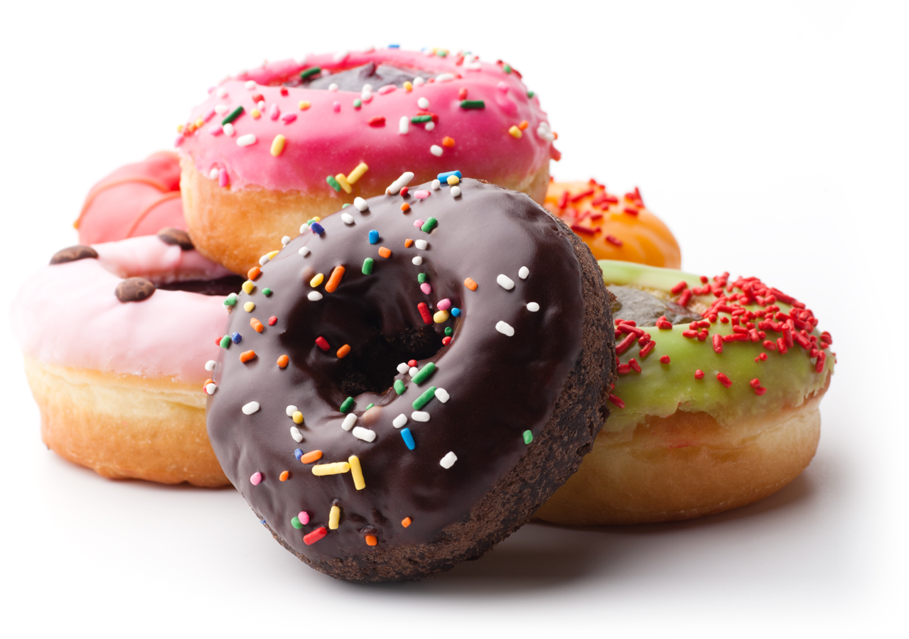
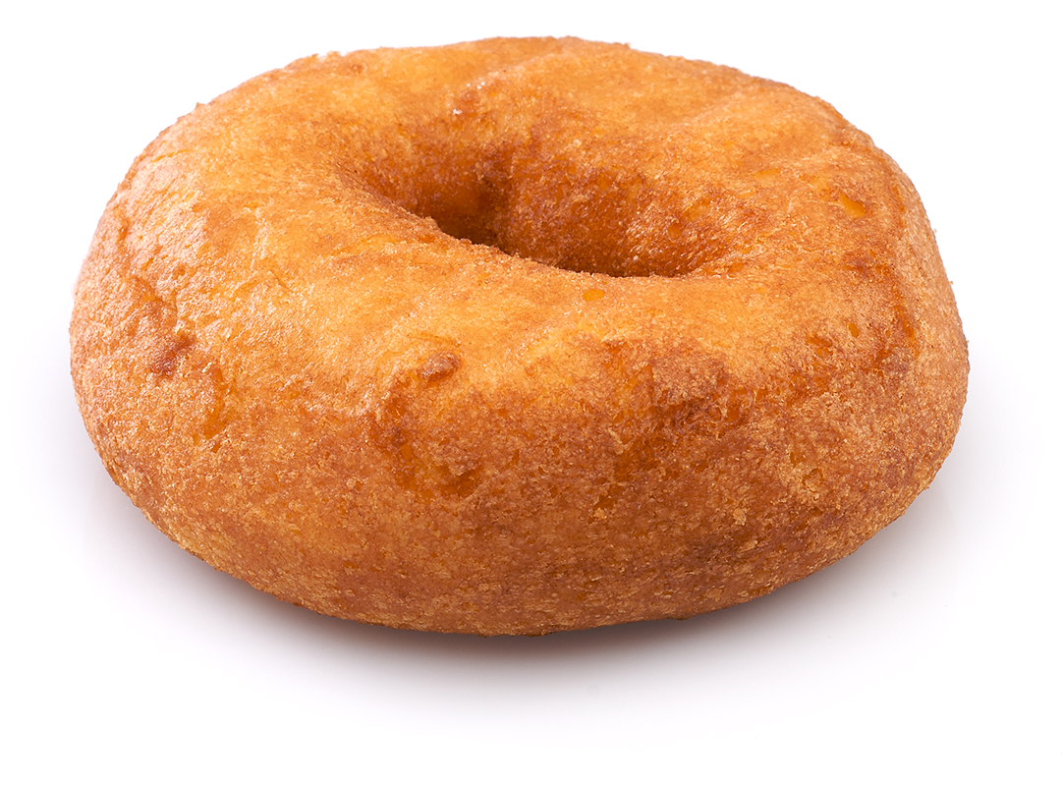
Minimum Viable Product
A product with just enough features to satisfy early customers and provide feedback for future product development
Minimum Viable Product: Product Vision:
wikipedia.org
Notes:
Shutterstock_46018207
shutterstock_107698130

Slide 15
How do we determine our MVP?

Slide 16
Determining a Minimum Viable Product
Ask Questions!
Who is your audience?
What is the problem that the product will address?
How does the product solve that problem?

Slide 17
What is a user story?

Slide 18
User stories
As a <type of user>
Who are we building this for?
AS A marketing analyst
I want <some goal>
What is the user trying to achieve?
I WANT to see referral traffic
(so that <benefit>).
Why do they want to achieve this?
SO THAT I can convert more leads

Slide 19
User stories
As a <type of user>
Who are we building this for?
AS A marketing analyst
I want <some goal>
What is the user trying to achieve?
I WANT to see referral traffic
(so that <benefit>).
Why do they want to achieve this?
SO THAT I can convert more leads

Slide 20
User stories
As a <type of user>
Who are we building this for?
AS A marketing analyst
I want <some goal>
What is the user trying to achieve?
I WANT to see referral traffic
(so that <benefit>).
Why do they want to achieve this?
SO THAT I can convert more leads

Slide 21
What is acceptance criteria?

Slide 22
Acceptance Criteria
GIVEN some precondition
GIVEN I am an authenticated user
WHEN I do some action
WHEN I request a range of referral traffic
THEN I expect some result
THEN a chart is generated

Slide 23
Acceptance Criteria
GIVEN some precondition
GIVEN I am an authenticated user
WHEN I do some action
WHEN I request a range of referral traffic
THEN I expect some result
THEN a chart is generated

Slide 24
What is an Issue?

Slide 25
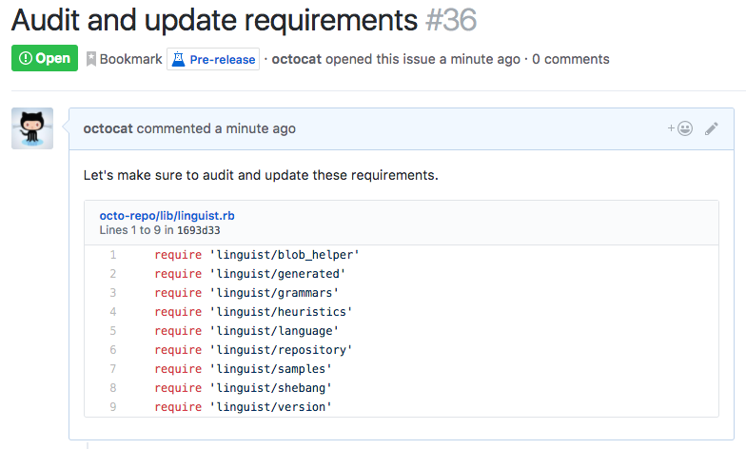
Issues
Use issues to track ideas, enhancements, tasks, or bugs for work on GitHub.
help.github.com

Slide 26
GitHub Issues

Slide 27
Student Activity: User Stories
User stories help provide context for a development team and their efforts moving forward
5 minutes

Slide 28
Student Activity: User Stories
In a markdown file or with a pen and piece of paper, create a user story for a mock persona using one of the following prompts:
01
A web application that keeps track of a company’s payroll.
02
A mobile application that finds nearby restaurants.
03
A reminder app that keeps track of important tasks.

Slide 29
What is kanban?

Slide 30
Kanban
Kanban is a project management tool that visualizes work through cards representing User Stories or Issues.
In their simplest form, Kanban boards are broken into three columns:
To Do | In Progress | Done
Cards begin in the To Do column and are moved from left to right as work is started and completed.

Slide 31
GitHub Projects

Slide 32
Student Activity: GitHub Projects
Kanban boards help developers visualize work and keep track of the status of issues.
10 minutes

Slide 33
Student Activity: GitHub Projects
Navigate to github.com and create a repository.
Create a new project for your repository.
Create a card called “Create landing page” and move it from the “To do” column to “In progress”.
Create a GitHub Issue called “Fix broken button” and attach it to your new project.

Slide 34
What is daily scrum?

Slide 35
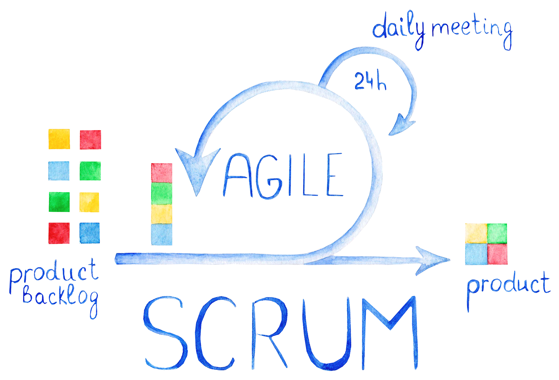
Stand-Up Meetings
01
What was accomplished?
02
What are your goals?
03
Are there any obstacles to achieving your goals?
Notes:
shutterstock_757928980

Slide 36
Project Timeline
First Day of Unit 07 | Divide into groups. Write a user story. Create a wireframe. Create a user flow diagram. Submit project proposal for approval.
Units 07–08 | Continue project development. Prepare for presentations.
Last Day of Unit 08 | Give presentations!

Slide 37
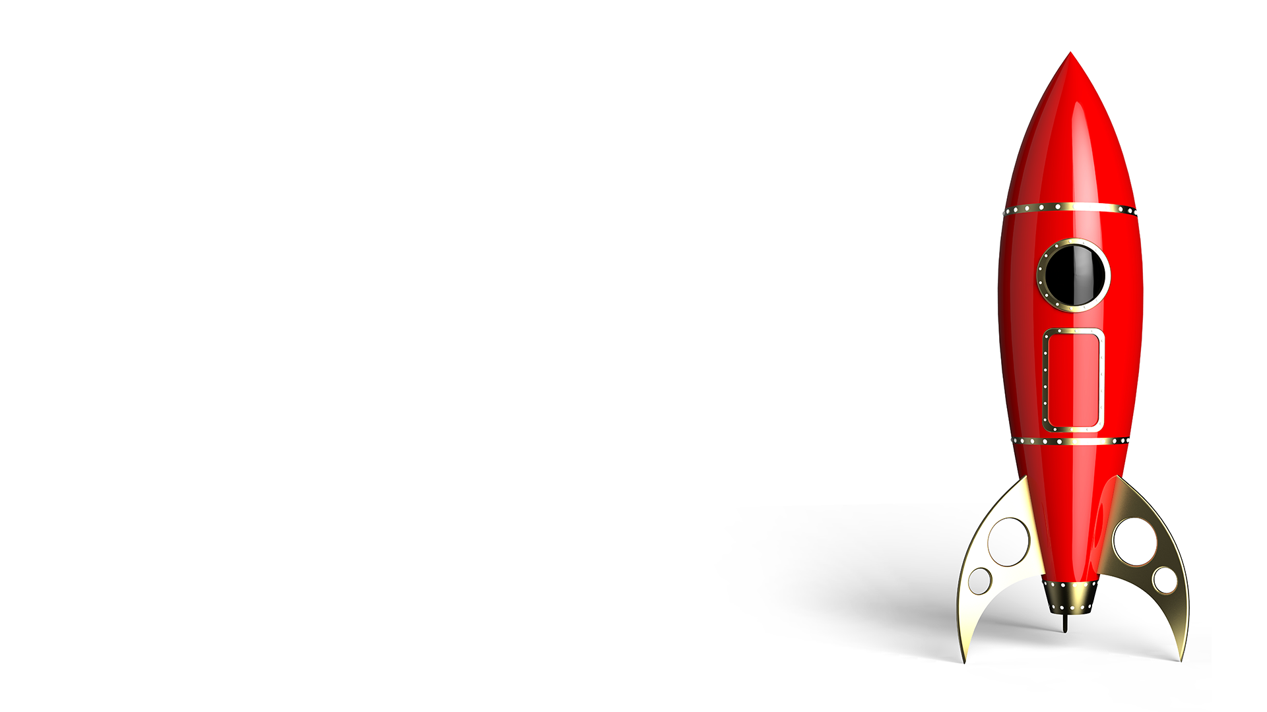
Get Professional
Projects are portfolio pieces
Use Project Week as an opportunity to push yourself and prove what you know.

Slide 38
Project Requirements
Must use at least two server-side APIs
Must use a CSS framework other than Bootstrap
Must use client-side storage to store persistent data
Must have a polished UI
Must meet good quality coding standards (indentation, scoping, naming, etc.)
Must NOT use alerts, confirms, or prompts (look into modals).
Must be deployed to GitHub Pages
Must be interactive (i.e: accept and respond to user input)

Slide 39
What is daily scrum?

Slide 40
Presentation Requirements
You will be responsible for preparing a formal, 10-minute presentation that covers the following:
Elevator pitch | A one minute description of your application
Concept | What is your user story? What was your motivation for development?
Process | What were the technologies used? How were tasks and roles broken down and assigned? What challenges did you encounter? What were your successes?
Demo | Show your stuff!
Directions | For Future Development
Links | To the deployed application and the GitHub repository

Slide 41
What is daily scrum?

Slide 42
Grading Requirements
Your project will be evaluated on the following:
Technical Acceptance Criteria
Concept
Deployment
Repository Quality
Application Quality
Presentation
Collaboration

Slide 43
API Suggestions
Stick to APIs that do all of the following:
Allow cross-origin resource sharing (CORS)
Require simple or no authentication
Return a JSON response
Are well-documented
For a list of free APIs see: API Resources Blog Post on Full-Stack Blog

Slide 44
Today’s Project Checklist
Create a one page proposal that contains the following:
Project title
Project description
User story
Wireframe or sketch of the design
APIs to be used
Rough breakdown of tasks

